Slide 1

Machine Learning with Scikit-Learn

Slide 2

Plan of Study
Preface
An Architecture for ML Data Products
What is Scikit-Learn?
Data Handling and Loading
Model Evaluation
Regressions
Clustering
Classification

Slide 3
Smoothing
Planning
Probability
Computer Vision
Normalization
Reinforcement
Distributions
Artificial Intelligence
Neural Models
Statistics
Bayes Theorem
Computer Vision
Regression
Anomaly Detection
Logits
Natural Language Processing
Entropy
Big Data Optimization
Computer Science
Data Mining
Function Approximation
Graph Algorithms
Is Machine Learning a one semester course?

Slide 4
What is Machine Learning?

Slide 5
Learning by Example
Given a bunch of examples (data) extract a meaningful pattern upon which to act.
Problem Domain | Machine Learning Class
Infer a function from labeled data | Supervised learning
Find structure of data without feedback | Unsupervised learning
Interact with environment towards goal | Reinforcement learning

Slide 6
How do you make predictions?

Slide 7
What patterns do you see?

Slide 8
What is the Y value?

Slide 9
How do you determine red from blue?

Slide 10
Types of Algorithms by Output
Input training data to fit a model which is then used to predict incoming inputs into ...
Type of Output | Algorithm Category
Output is one or more discrete classes | Classification (supervised)
Output is continuous | Regression (supervised)
Output is membership in a similar group | Clustering (unsupervised)
Output is simplified from higher dimensions | Dimensionality Reduction

Slide 11
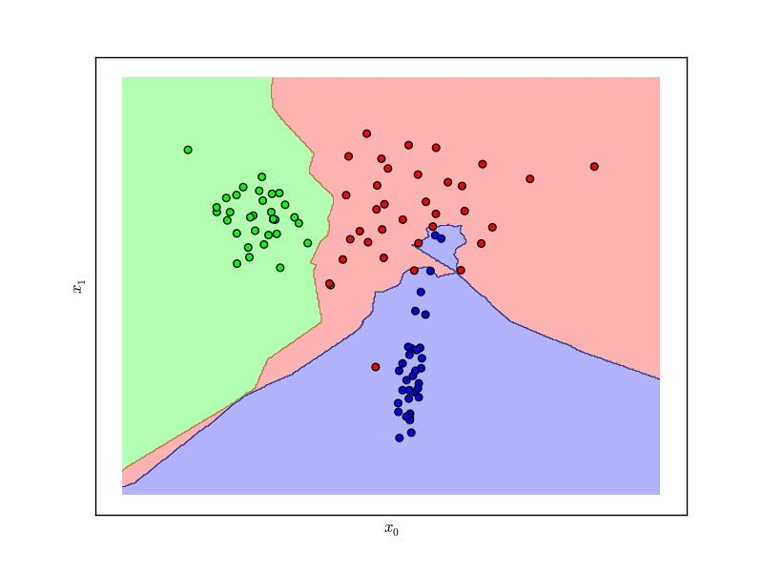
Classification
Given labeled input data (with two or more labels), fit a function that can determine for any input, what the label is.

Slide 12
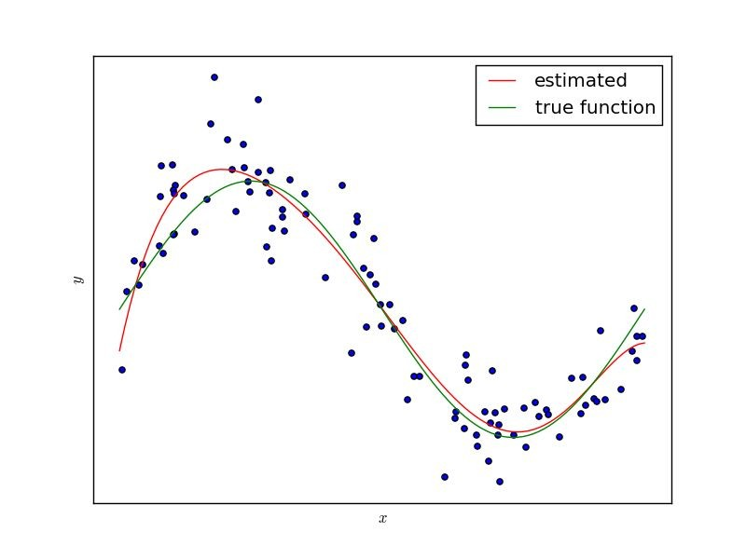
Regression
Given continuous input data fit a function that is able to predict the continuous value of input given other data.

Slide 13
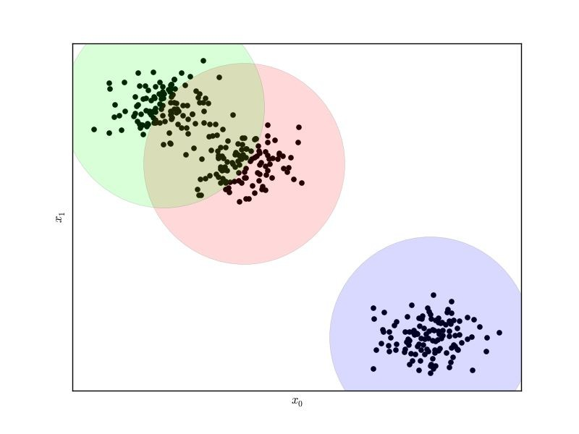
Clustering
Given data, determine a pattern of associated data points or clusters via their similarity or distance from one another.

Slide 14

Hadley Wickham (2015)
“Model” is an overloaded term.
Model form specifies exactly how the variables of interest are connected within the framework of the model family.
A fitted model is a concrete instance of the model form where all parameters have been estimated from data, and the model can be used to generate predictions.
http://had.co.nz/stat645/model-vis.pdf

Slide 15
Dimensions and Features
In order to do machine learning you need a data set containing instances (examples) that are composed of features from which you compose dimensions.
Instance: a single data point or example composed of fields
Feature: a quantity describing an instance
Dimension: one or more attributes that describe a property
from sklearn.datasets import load_digits digits = load_digits()
X = digits.data
y = digits.target
# X.shape == (n_samples, n_features)
# y.shape == (n_samples,)

Slide 16
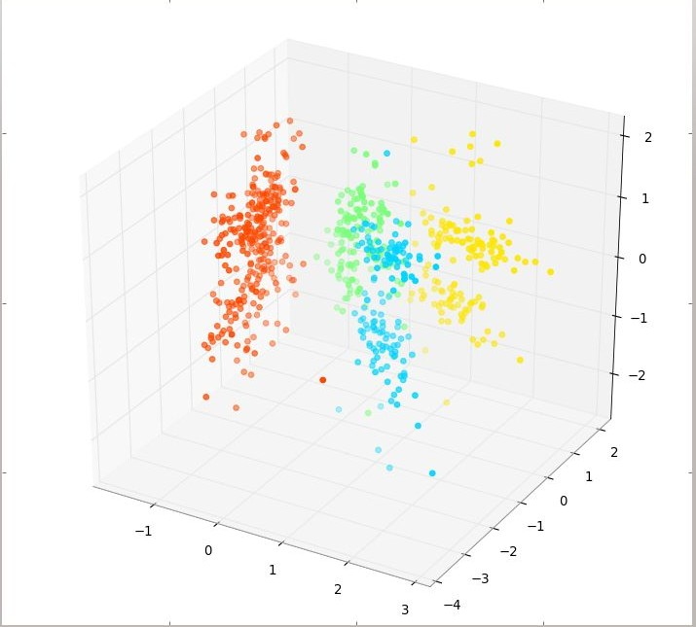
Feature Space
Feature space refers to the n-dimensions where your variables live (not including a target variable or class). The term is used often in ML literature because in ML all variables are features (usually) and feature extraction is the art of creating a space with decision boundaries.
Target
1. Y ≡ Thickness of car tires after some testing period
Variables
X₁ ≡ distance travelled in test
X₂ ≡ time duration of test
X₃ ≡ amount of chemical C in tires
The feature space is R³, or more accurately, the positive quadrant in R³ as all the X variables can only be positive quantities.
http://stats.stackexchange.com/questions/46425/what-is-feature-space

Slide 17
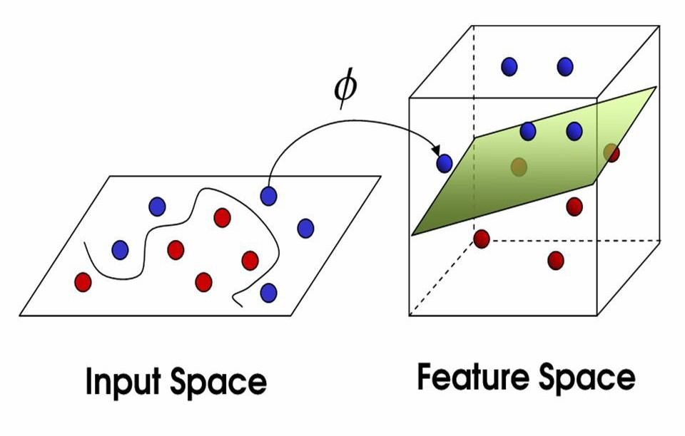
Mappings
Domain knowledge about tires might suggest that the speed the vehicle was moving at is important, hence we generate another variable, X₄ (this is the feature extraction part):
X₄ = X₁*X₂ ≡ the speed of the vehicle during testing.
This extends our old feature space into a new one, the positive part of R⁴. A mapping is a function, ϕ, from R³ to R⁴:
ϕ(x₁,x₂,x₃) = (x₁,x₂,x₃,x₁x₂)
http://stats.stackexchange.com/questions/46425/what-is-feature-space

Slide 18
Your Task
Given a data set of instances of size N, create a model that is fit from the data (built) by extracting features and dimensions. Then use that model to predict outcomes …
Data Wrangling (normalization, standardization, imputing)
Feature Analysis/Extraction
Model Selection/Building
Model Evaluation

Slide 19
A Tour of Machine Learning Algorithms

Slide 20
Models: Instance Methods
Compare instances in data set with a similarity measure to find best matches.
Suffers from curse of dimensionality.
Focus on feature representation and similarity metrics between instances
k-Nearest Neighbors (kNN)

Slide 21
Models: Kernel Methods
Map input data into higher dimensional vector space where the problem is easier to model.
Named after the “kernel trick” which computes the inner product of images of pairs of data.
Support Vector Machines (SVM)
Radial Basis Function (RBF)
Linear Discriminant Analysis (LDA)

Slide 22
Models: Artificial Neural Networks
Inspired by biological neural networks, ANNs are nonlinear function approximators that estimate functions with a large number of inputs.
System of interconnected neurons that activate
Deep learning extends simple networks recursively
Perceptron
Back-Propagation
Hopfield Network
Restricted Boltzmann Machine (RBM)
Deep Belief Networks (DBN)

Slide 23
Models: Ensembles
Models composed of multiple weak models that are trained independently and whose outputs are combined to make an overall prediction.
Boosting
Bootstrapped Aggregation (Bagging)
AdaBoost
Stacked Generalization (blending)
Gradient Boosting Machines (GBM)
Random Forest

Slide 24
An Architecture for Operationalizing Machine Learning Algorithms

Slide 25
Build Phase
 | Feature Vectors
Training Data
Estimation Algorithm
Labels
Operational Phase
New Data
Feature Vector
Predictive Model
Prediction
Architecture of Machine Learning Operations

Slide 26
What is Scikit-Learn?
Extensions to SciPy (Scientific Python) are called SciKits. SciKit-Learn provides machine learning algorithms.
Algorithms for supervised & unsupervised learning
Built on SciPy and Numpy
Standard Python API interface
Sits on top of c libraries, LAPACK, LibSVM, and Cython
Open Source: BSD License (part of Linux)
Probably the best general ML framework out there.

Slide 27

Where did it come from?
Started as a Google summer of code project in 2007 by David Cournapeau, then used as a thesis project by Matthieu Brucher.
In 2010, INRIA pushed the first public release, and sponsors the project, as do Google, Tinyclues, and the Python Software Foundation.

Slide 28
Primary Features
Generalized Linear Models
SVMs, kNN, Bayes, Decision Trees, Ensembles
Clustering
Cross Validation
Grid Search
Pipelining
Model Evaluations
Dataset Transformations
Dataset Loading

Slide 29
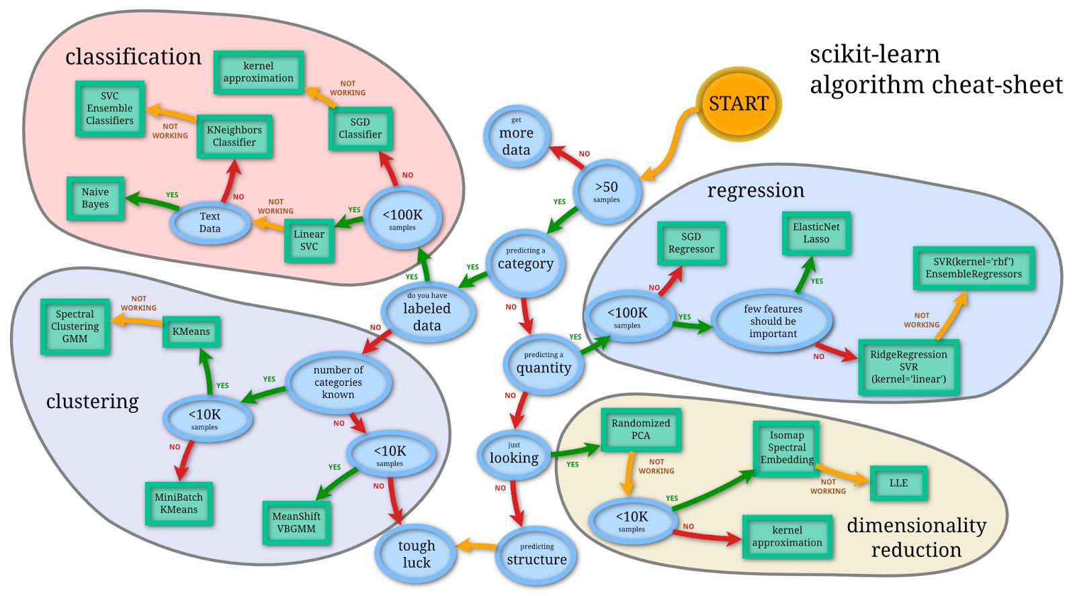
A Guide to Scikit-Learn

Slide 30
Scikit-Learn API
Object-oriented interface centered around the concept of an Estimator:
“An estimator is any object that learns from data; it may be a classification, regression or clustering algorithm or a transformer that extracts/filters useful features from raw data.”
- Scikit-Learn Tutorial

Slide 31
Estimators
fit(X,y) sets the state of the estimator.
X is usually a 2D numpy array of shape
(num_samples, num_features).
y is a 1D array with shape (n_samples,)
predict(X) returns the class or value

Slide 32
from sklearn import svm
estimator = svm.SVC() estimator.fit(X, y) estimator.predict(x)
Basic methodology

Slide 33
Wrapping fit and predict
We’ve already discussed a broad workflow, the following is a development workflow:
Raw Data
Feature Extraction
Feature Evaluation
Evaluate Model
Load & Transform Data
Build Model

Slide 34
Iris Datase
This data sets consists of 3 different types of irises’ (Setosa, Versicolour, and Virginica) petal and sepal length, stored in a 150x4 numpy.ndarray
The rows being the samples and the columns being: Sepal Length, Sepal Width, Petal Length and Petal Width

Slide 35
Scikit-learn 4-step modeling pattern
Import the class you plan to use
Instantiate the estimator
Estimator id scikit-learn term for model
Instantiate means make an instance of
Can specify tuning parameter during this step
Fit the model with data(model training)
Model is learning the relationship between X and y
Predict the response for a new observation
New observations are called “out-of-sample” data
Uses the information it learned during the model training process
Return a Numpy Array
ICE with another parameter model tuning
Import the class you plan to use
from sklearn import svm
model=svm.SVC()
model.fit(x,y)
model.predict(x)

Slide 36
Evaluation

Slide 37
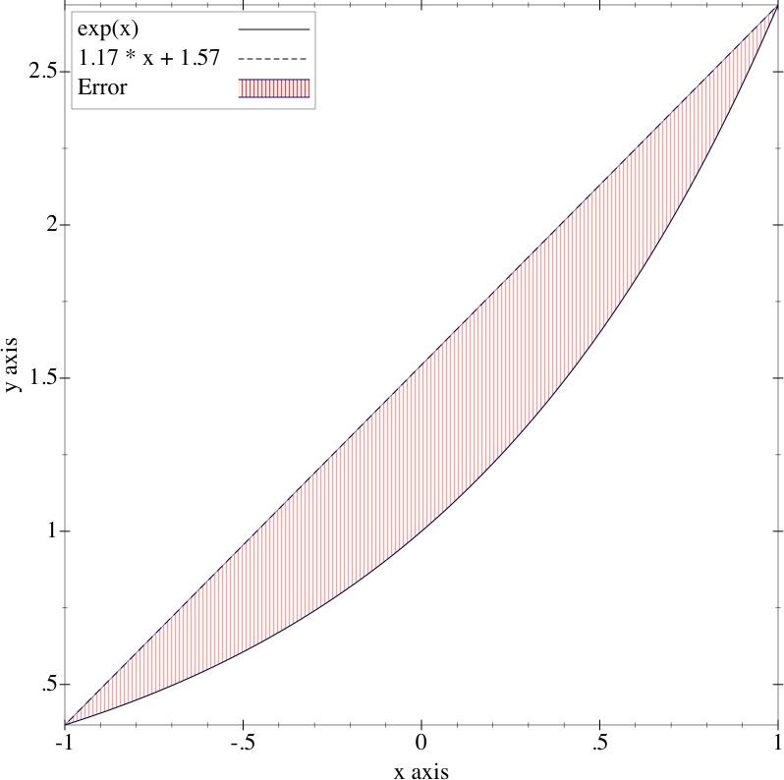
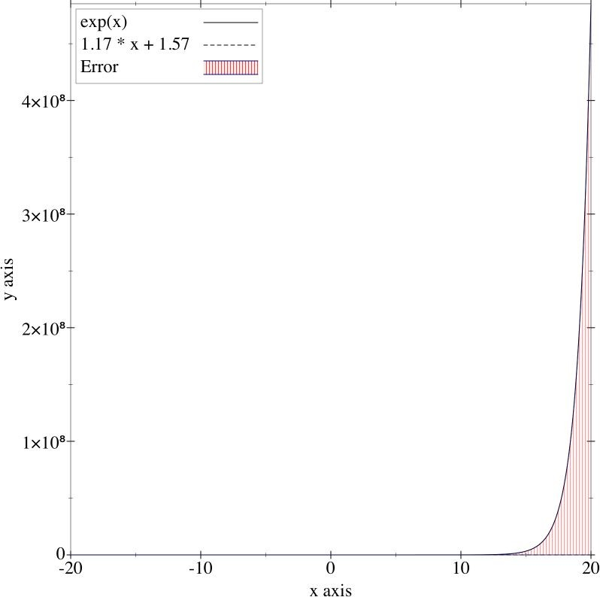
Underfitting
Not enough information to accurately model real life. Can be due to high bias, or just a too simplistic model.
Solution: Cross Validation

Slide 38
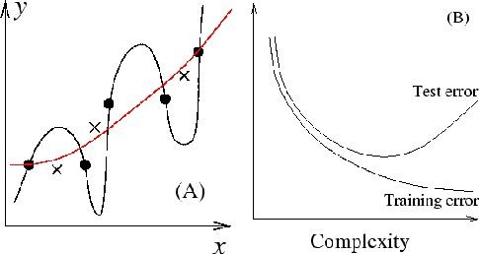
Overfitting
Create a model with too many parameters or is too complex. “Memorization of the data” - and the model can’t generalize very well.
Solution: Benchmark Testing, Ridge Regression, Feature Analyses, Dimensionality Reduction

Slide 39
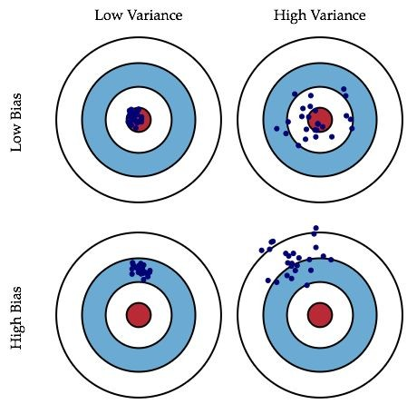
Error: Bias vs Variance
Bias: the difference between expected (average) prediction of the model and the correct value.
Variance: how the predictions for a given point vary between different realizations for the model.
http://scott.fortmann-roe.com/docs/BiasVariance.html

Slide 40
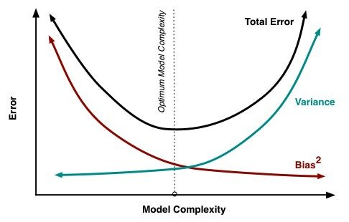
Bias vs. Variance Trade-Off
Related to model complexity:
The more parameters added to the model (the more complex), Bias is reduced, and variance increased.
Sources of complexity:
k (nearest neighbors)
epochs (neural nets)
# of features
learning rate
http://scott.fortmann-roe.com/docs/BiasVariance.html

Slide 41
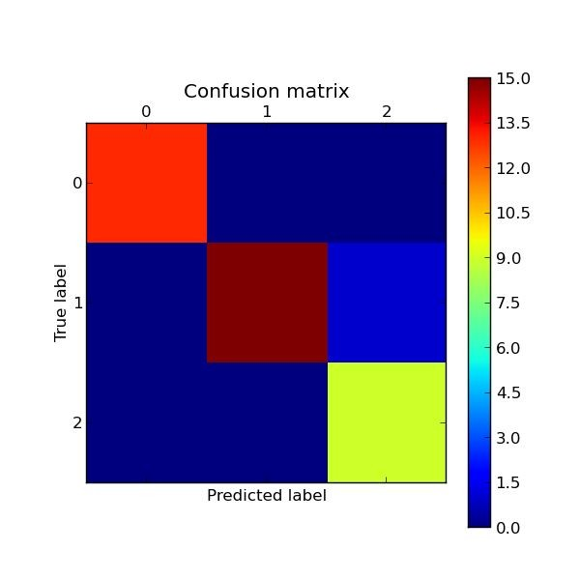
Cross Validation (classification)
Assess how model will generalize to independent data set (e.g. data not in the training set).
Divide data into training and test splits
Fit model on training, predict on test
Determine accuracy, precision and recall
Repeat k times with different splits then average as F1
 | Predicted Class A | Predicted Class B
Actual A | True A | False B | #A
Actual B | False A | True B | #B
 | #P(A) | #P(B) | total

Slide 42
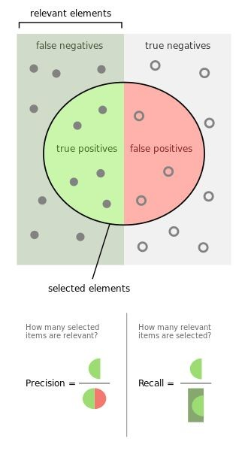
accuracy =
true positives + true negatives / total
precision =
true positives / (true positives + false positives)
recall =
true positives / (false negatives + true positives)
F1 score =
2 * ((precision * recall) / (precision + recall))
https://en.wikipedia.org/wiki/Precision_and_recall

Slide 43
How to do evaluation in scikit learn

Slide 44
Evaluation Procedure:Train/Test split
Split the dataset into two sets
Train the model on the Training set
Test the model on the Testing Set, and evaluate how well we did

Slide 45
from sklearn import metrics
from sklearn import cross_validation as cv
splits
= cv.train_test_split(X, y, test_size=0.2)
X_train, X_test, y_train, y_test = splits
model = ClassifierEstimator() model.fit(X_train, y_train)
expected predicted
= y_test
= model.predict(X_test)
print metrics.classification_report(expected, predicted) print metrics.confusion_matrix(expected, predicted) print metrics.f1_score(expected, predicted)
Cross Validation in Scikit-Learn

Slide 46
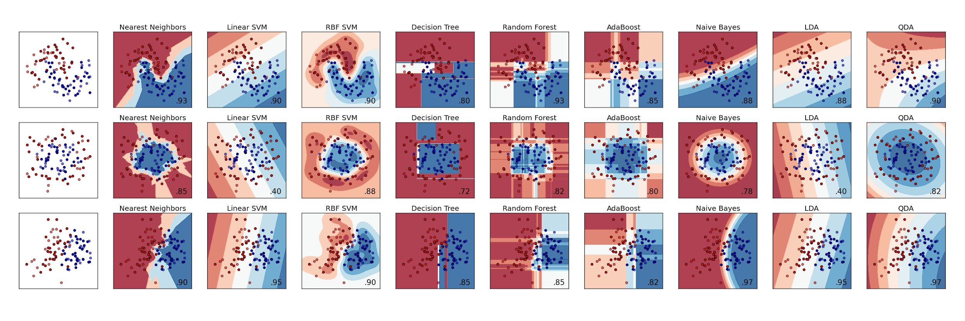
Other Evaluation
How to evaluate clusters? Visualization (but only in 2D)

Slide 47

Unpredictable Future
Machine learning models attempt to predict the future as new inputs come in - but human systems and processes are subject to change.
Solution: Precision/Recall tracking over time

Slide 48

Questions, Comments?

